Slide 1
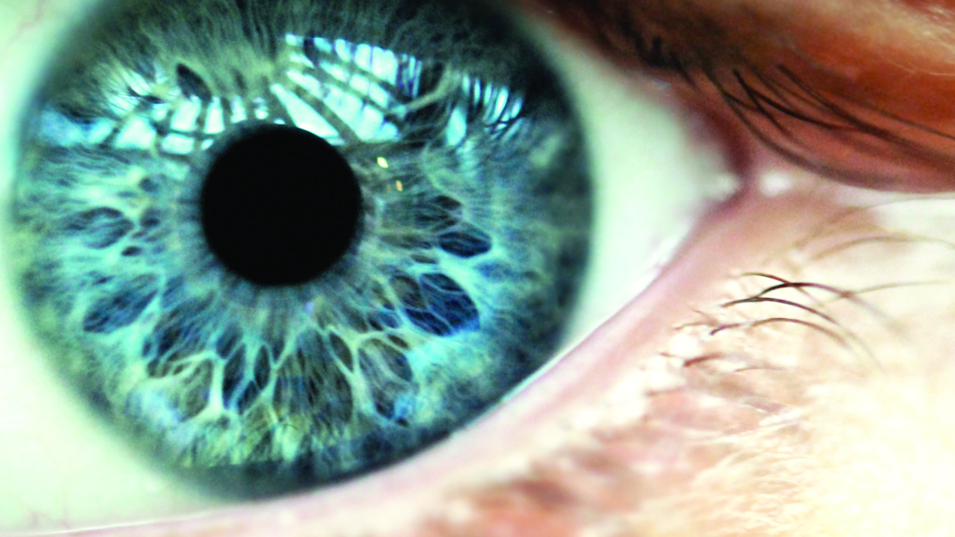
CHANGE LIVES DAILY
Be a Doctor of Optometry
November 2025

Slide 2

How do Doctors of Optometry Change Lives Daily?
Patient Care
Help people and improve their lives!
Protect the most valued sense: VISION
Diagnose, treat, and manage diseases and diseases of the human eye and
visual system
SPECIAL INTERESTS
Provide vision therapy and low-vision rehabilitation
Diagnose and treat ocular disease
Provide pediatric eye care
Participate as an interprofessional health care team member
Volunteer to provide eye care on mission trips
Provide care for special populations: veterans, seniors and athletes

Slide 3
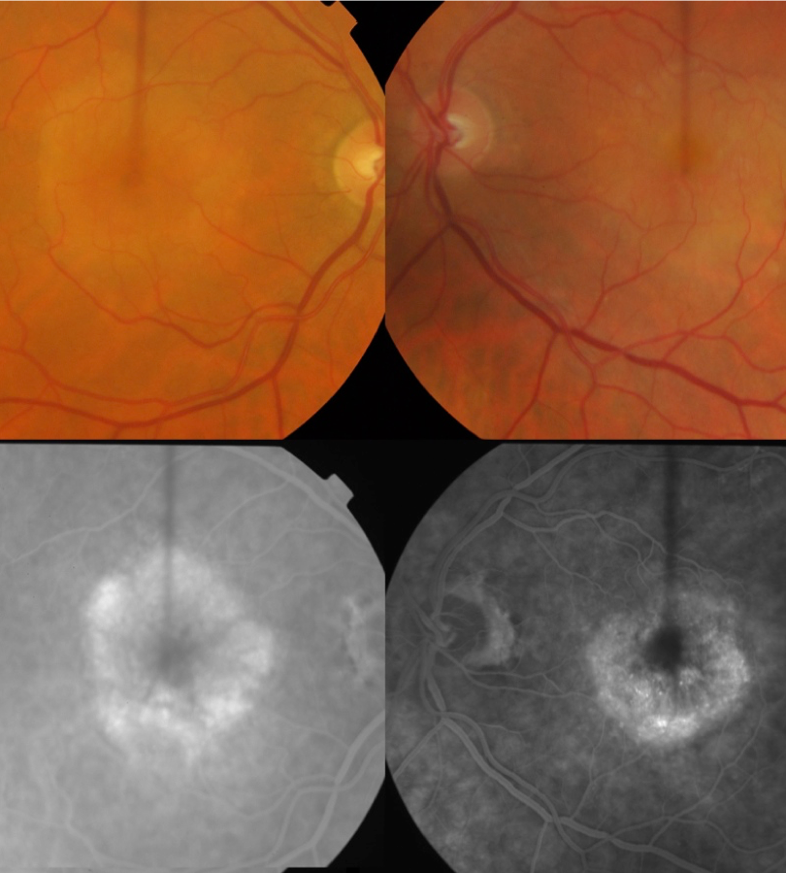
INCREASING NEED
What is the Future for Doctors
of Optometry?
12 million Americans
(>40 years) are either blind or visually impaired
6.8% of children have a diagnosed eye and vision condition
Nearly 5 million Americans
(20-74 years) have diabetic eye complications
20.5 million Americans
(>40 years) have cataracts
Source: Centers for Disease Control and Prevention

Slide 4


DOCTOR OF OPTOMETRY: A GROWING PROFESSION WITH HIGH CAREER RANKINGS
Federal data indicates employment of Optometrists is projected to grow 8% through 2034 (faster than the average for all occupations).
Growing population requiring good vision
Aging population needing vision care
Health insurance plans including vision care
Screen time has increased the onset of nearsightedness, dry eyes and other ocular conditions

Slide 5
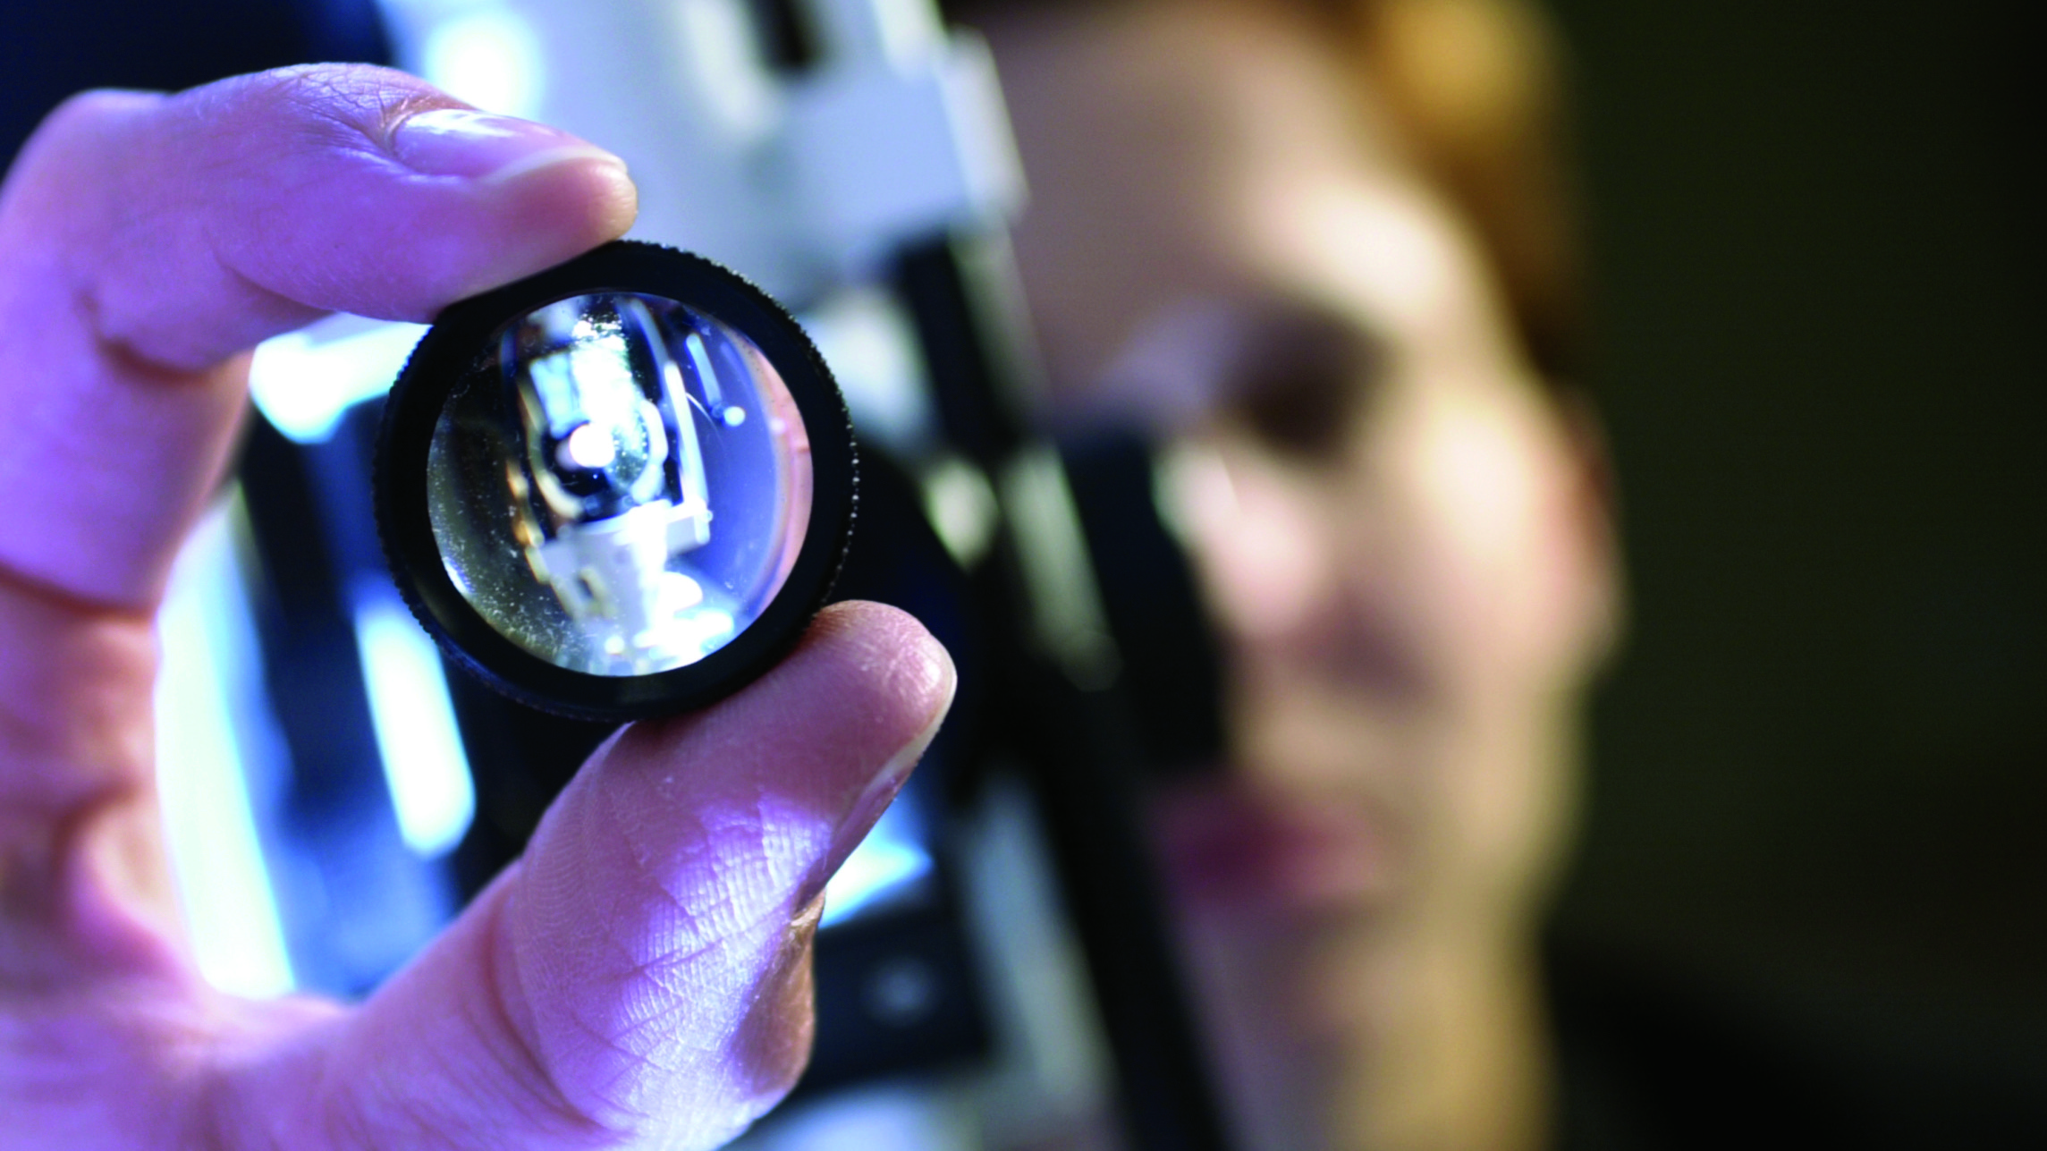






DOCTOR OF OPTOMETRY: Unlimited Career Paths
Individual Private Practice
Partnership or Group Practice
Academic/ Research
Military/VA/
Public Health
Interdisciplinary Care
Corporate or
Professional Affairs
Optometry/Ophthalmology Professional Setting

Slide 6
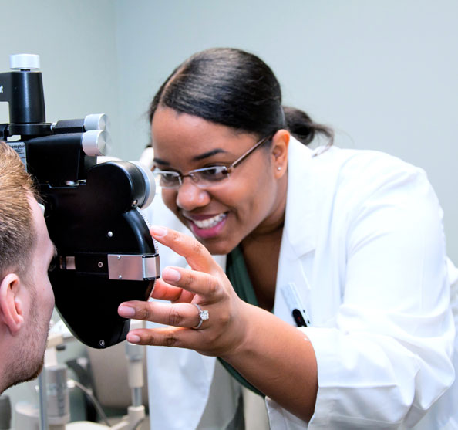
$168,193
The average net income for Doctors of Optometry
DOCTOR OF OPTOMETRY:
Financially Rewarding
According to the
2022 AOA Survey of Optometric Practice

Slide 7
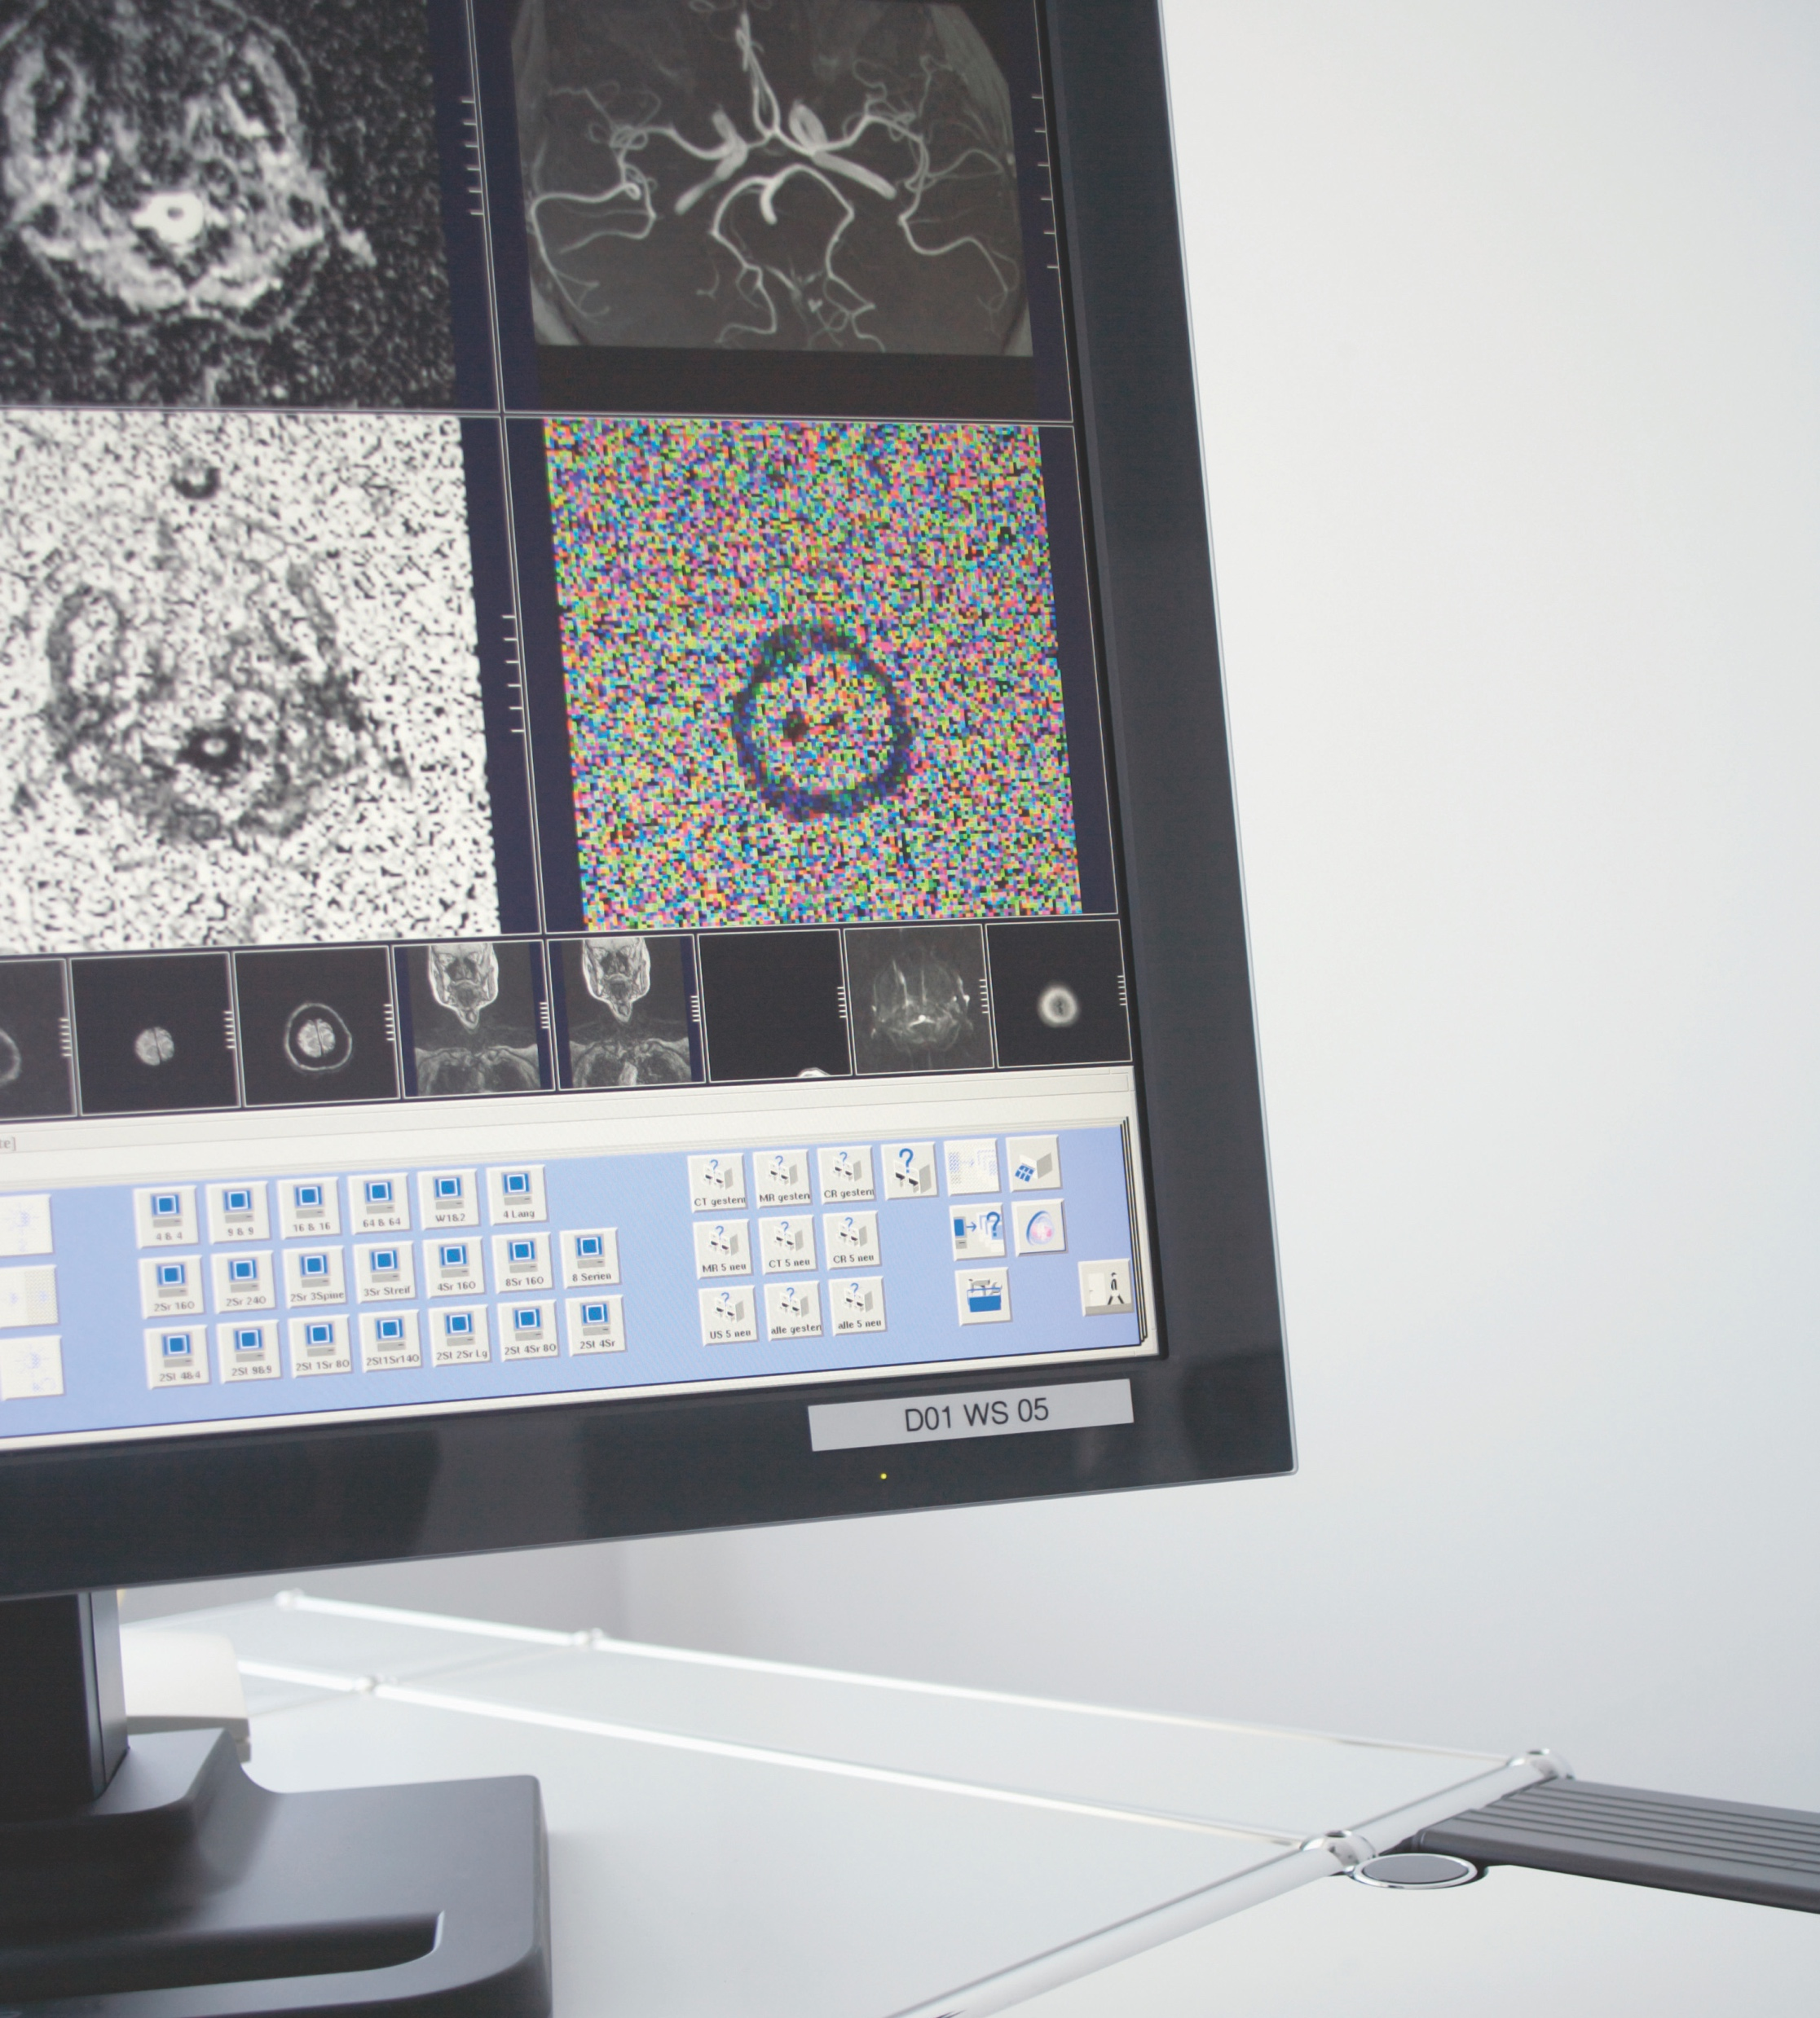
New technology to reduce myopia progression
LCD driven electronic lenses
3D vision correction
Bioptic telescope
Innovations in drug delivery
Glaucoma and diabetes monitoring contact lenses
Biofilms
Artificial intelligence in disease management
DOCTOR OF OPTOMETRY:
CUTTING EDGE TECHNOLOGY

Slide 8
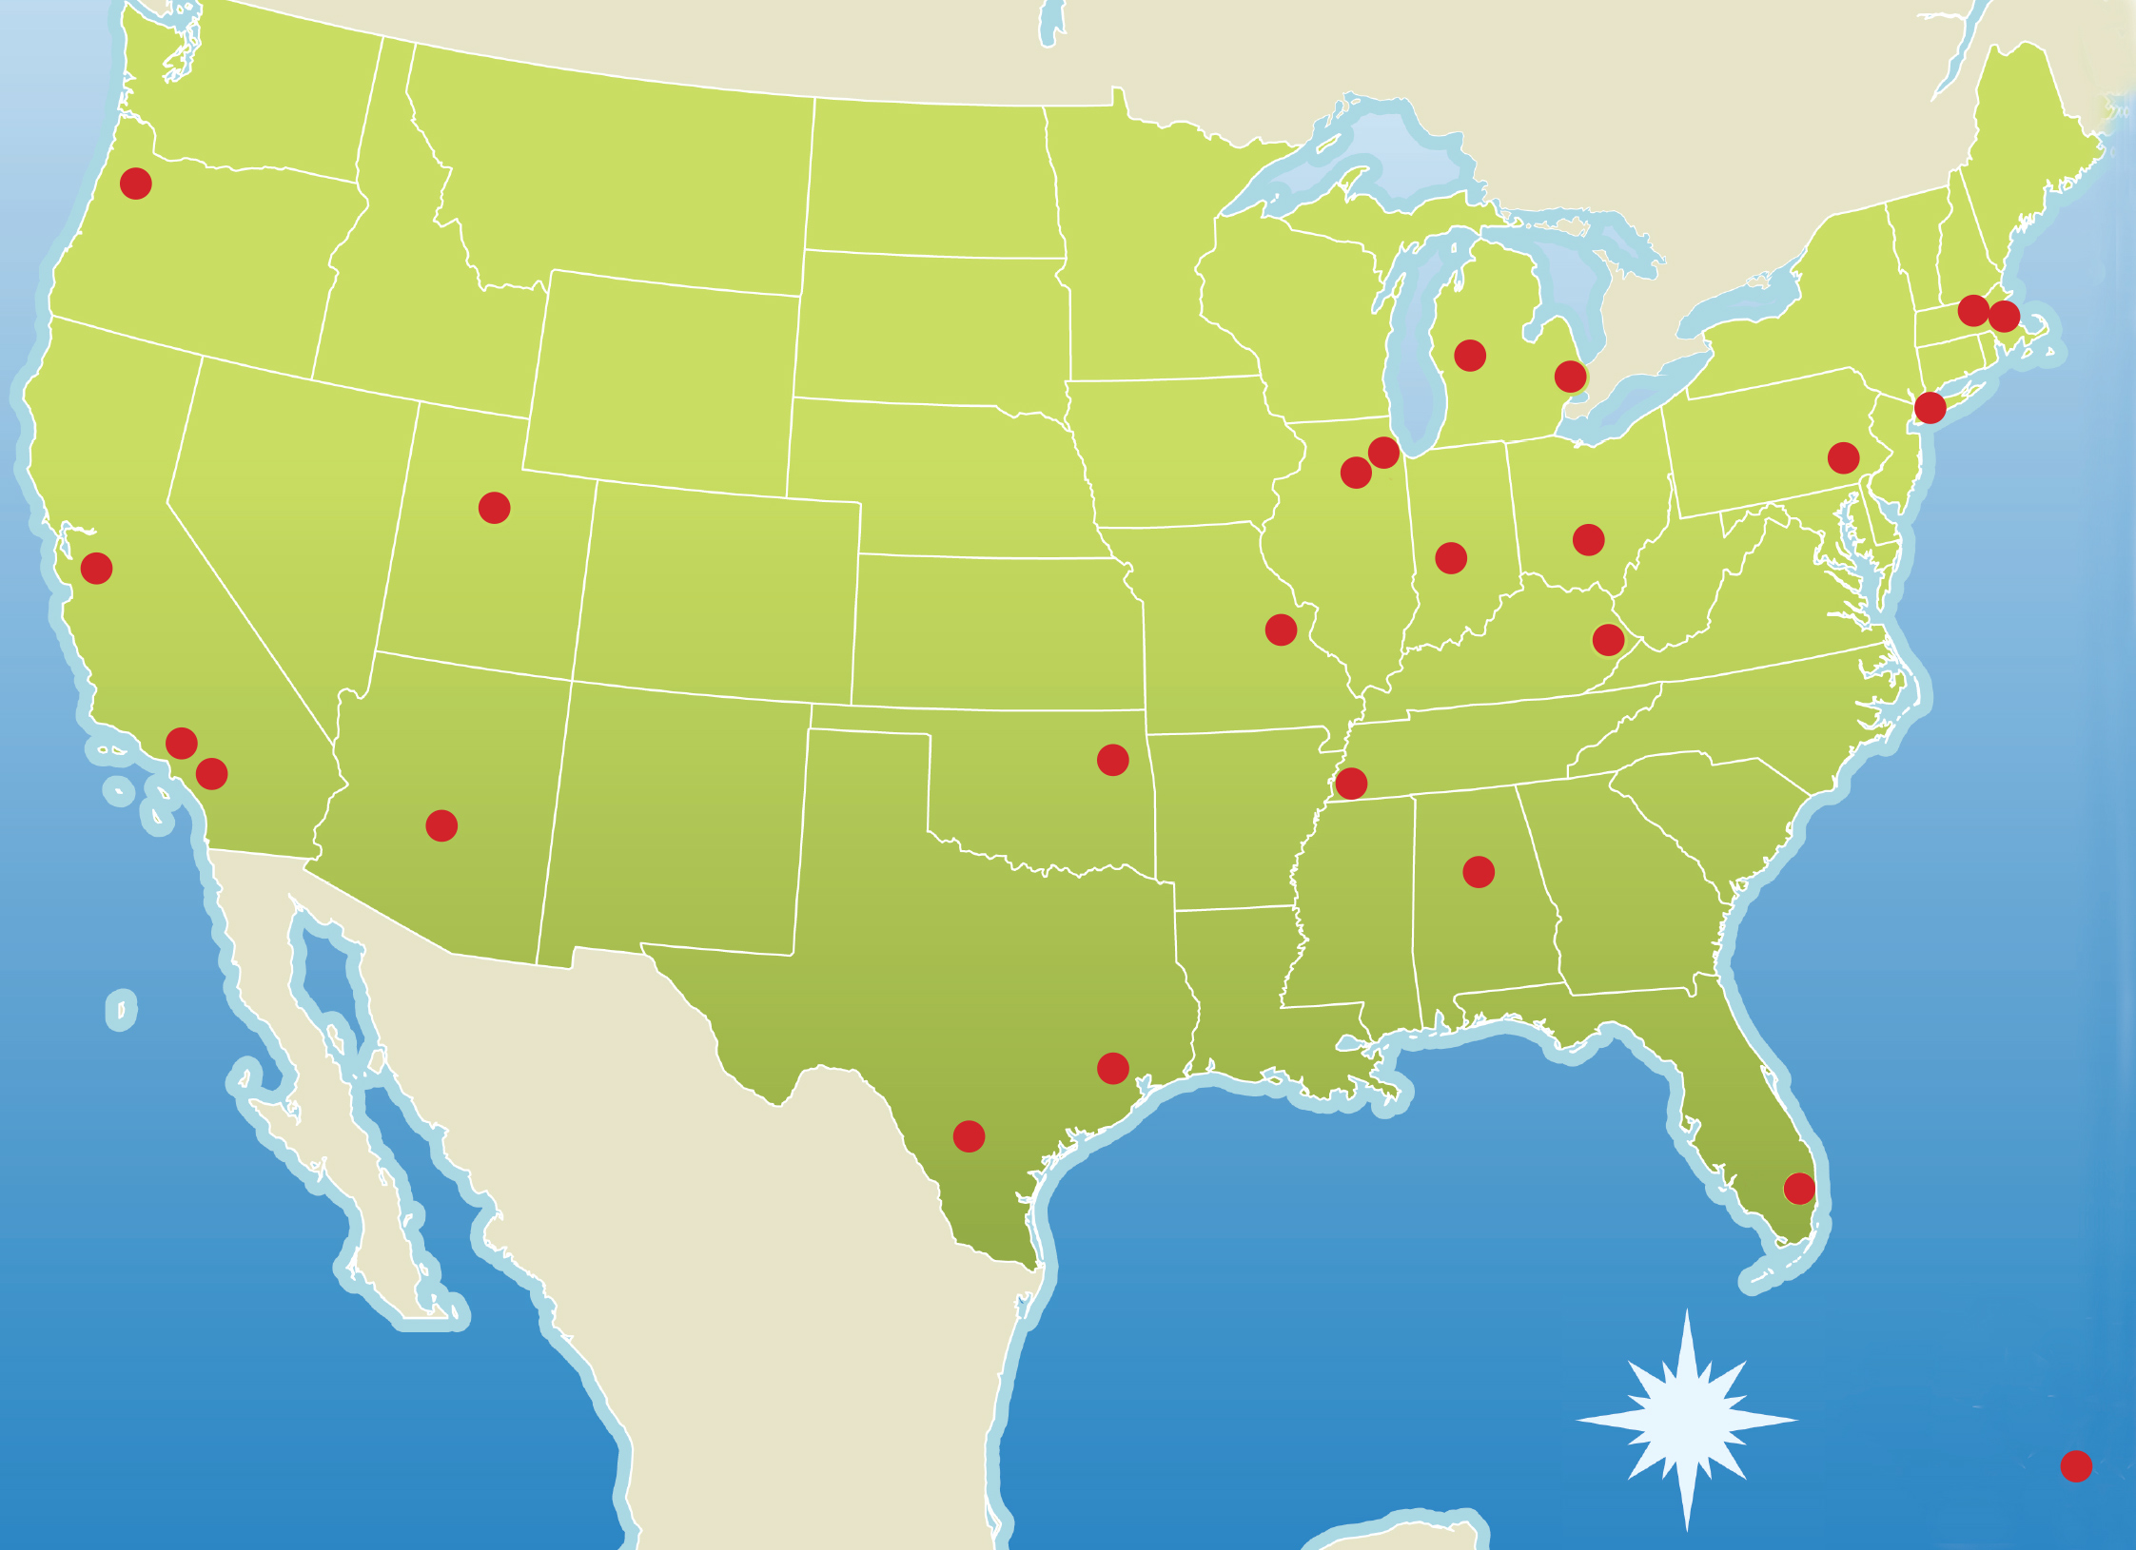
SCHOOLS AND Colleges of optometry
HERE’s WHERE YOU CAN GET YOUR OPTOMETRY DEGREE:
ALABAMA
University of Alabama at Birmingham School of Optometry, Birmingham, Alabama
ARIZONA
Midwestern University – Arizona College of Optometry, Glendale, Arizona
CALIFORNIA
Southern California College of Optometry at Marshall B. Ketchum University, Fullerton, California
University of California, Berkeley Herbert Wertheim School of Optometry and Vision Science, Berkeley, California
Western University of Health Sciences College of Optometry, Pomona, California
FLORIDA
Nova Southeastern University College of Optometry, Ft. Lauderdale, Florida
ILLINOIS
Chicago College of Optometry at Midwestern University, Downers Grove, Illinois
Illinois College of Optometry, Chicago, Illinois
INDIANA
Indiana University School of Optometry, Bloomington, Indiana
KENTUCKY
University of Pikeville – Kentucky College of Optometry, Pikeville, Kentucky
MASSACHUSETTS
MCPHS University School of Optometry, Worcester, Massachusetts
New England College of Optometry, Boston, Massachusetts
MICHIGAN
Michigan College of Optometry at Ferris State University, Big Rapids, Michigan
MICHIGAN
University of Detroit-Mercy School of Optometry, Novi, Michigan
MISSOURI
University of Missouri at St. Louis College of Optometry, St. Louis, Missouri
NEW YORK
State University of New York College of Optometry, New York, New York
OHIO
The Ohio State University College of Optometry, Columbus, Ohio
OKLAHOMA
Northeastern State University, Oklahoma College of Optometry , Tahlequah, Oklahoma
OREGON
Pacific University College of Optometry, Forest Grove, Oregon
PENNSYLVANIA
Salus University Pennsylvania College of Optometry , Elkins Park, Pennsylvania
PUERTO RICO
Inter American University of Puerto Rico School of Optometry, Bayamon, Puerto Rico
TENNESSEE
Southern College of Optometry, Memphis, Tennessee
TEXAS
University of Houston College of Optometry, Houston, Texas
University of the Incarnate Word Rosenberg School of Optometry, San Antonio, Texas
UTAH
Rocky Mountain University of Health Professions, Provo, Utah

Slide 9

LISTED BELOW ARE THE COMMON PREREQUISITE COURSES FOR MOST OPTOMETRY SCHOOLS:
General Biology with labs
General Chemistry with labs
Organic Chemistry with labs
Biochemistry
Microbiology with labs
Physics with labs
Anatomy and Physiology
Calculus
Psychology
Statistics
English
DOCTOR OF OPTOMETRY:
TYPICAL PREREQUISITES
* Most candidates for optometry school complete a Bachelor’s degree.

Slide 10
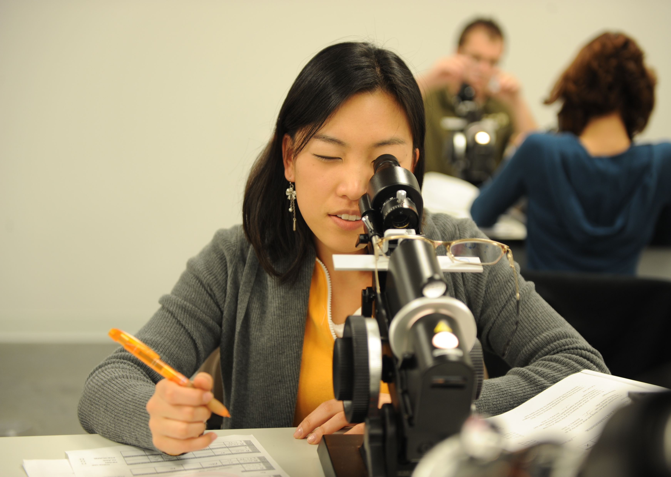
First year: Human Anatomy, Physiology, Pathology, Medical Sciences, Optics, Clinical Optometric Procedures leading to start of patient care
Second and Third year: Optometric courses such as Pharmacology, Contact Lenses, and Pediatric Optometry combined with hands-on patient care
Fourth year: Clinical Internships & Externships
Residencies (Optional):
  One year duration
  Residencies are located within hospitals, VA facilities, outpatient clinics, or clinical facilities of the various schools and colleges of optometry and offer a variety of areas of emphasis
DOCTOR OF OPTOMETRY:
FOUR YEAR OD PROGRAM

Slide 11
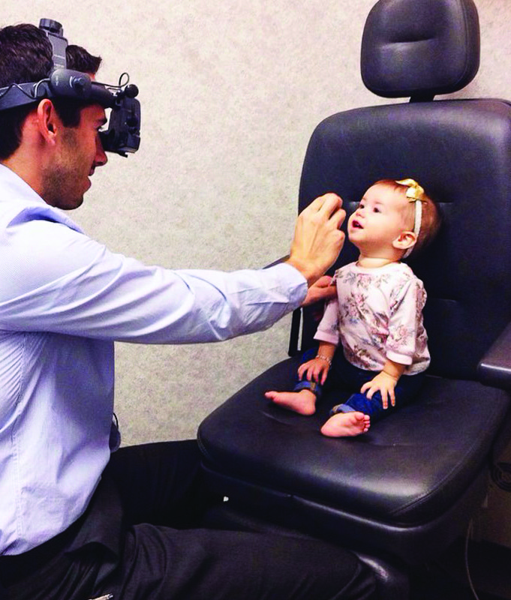
DOCTOR OF OPTOMETRY:
WHY SUCH A DESIRABLE PROFESSION?
Unlimited career paths
Great work/life balance
Caregivers that make a real difference
Vision is our most valued sense

Slide 12
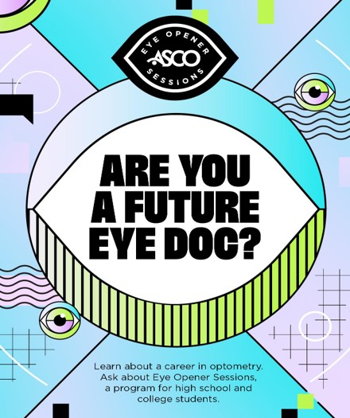
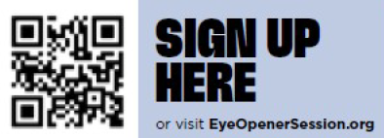
Doctor of Optometry: Where can I learn more?
The most valuable resource that inspired future applications was direct access to an OD mentor.
The Eye Opener Sessions program is designed to connect students who are curious about optometry with practicing ODs who want to inspire future ODs!

Slide 13
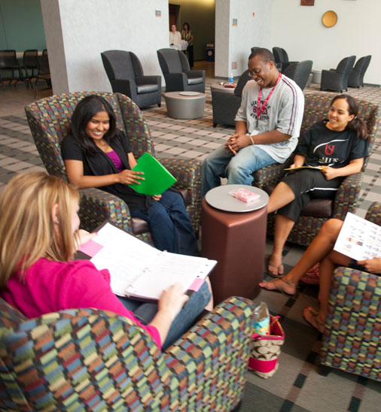
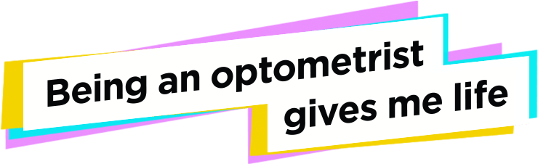
Futureeyedoc.org
ASCO: optometriceducation.org
  Videos, blogs, application information,
  social media
OptomCAS: optomcas.org
  To apply to optometry school
AOA: aoa.org
  American Optometric Association
AAO: aaopt.org
  American Academy of Optometry
AOSA: theaosa.org
  American Optometric Student Association
DOCTOR OF OPTOMETRY:
Other Ways I CAN LEARN MORE?

Slide 14
